Slide 1
Hello!
We’ll start at 3:03pm Pacific Time
Creating powerful data analysis applications
with dash in python

Slide 2

Creating powerful data analysis applications with dash in python
Jimmy Calvo Monge

Slide 3

Hello!
My name is Jimmy Calvo Monge and I’m a data scientist / statistician working at the MPE Statistics and Data Analysis Team, at APF TLO.
In my work I develop dashboards and tools for data analysis / visualization … and I use a python library called dash to do that.
Creating powerful data analysis applications
with dash in python

Slide 4


Questions:
Join at slido #3744255
https://www.slido.com/
Do you have python experience?
Have you developed or helped in the development of a dashboard/data visualization tool at Intel?
If yes, what technologies have you used?
Have you been a client of a data visualization tool here at intel? Which one(s)?
Creating powerful data analysis applications
with dash in python

Slide 5


Do you have experience coding in python?
ⓘ Start presenting to display the poll results on this slide.

Slide 6

Have you developed or helped in the development of a dashboard/data visualization tool at Intel? If yes, what technologies have you used to create dashboards?
ⓘ Start presenting to display the poll results on this slide.

Slide 7

Have you been a client of a data visualization tool here at Intel? Which one(s)?
ⓘ Start presenting to display the poll results on this slide.

Slide 8

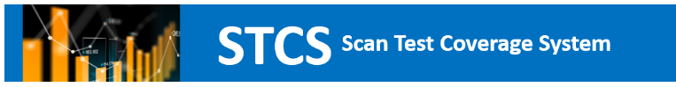
Apps using dash:
You might have seen our morning presentation about WANDA. This is a PPV data dashboard done completely in dash.
Another tool in the TLO Office is the STCS dashboard. This is done to quantify and visualize scan data.
goto/wanda
goto/stcs
Creating powerful data analysis applications
with dash in python

Slide 9

Why are we giving this talk?
Dash has been useful for our teams in developing these tools.
Through dash we were able to solve some visualization and UX requirements. We have expanded our tool’s capabilites.
Hence, today I would like to share the advantages, basic usage and our experiences with dash.
Creating powerful data analysis applications
with dash in python

Slide 10


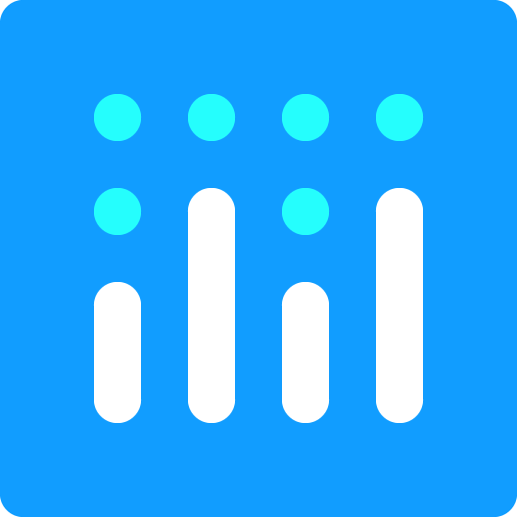
Contents:
Why should I use dash?
Usage of dash:
The layout – callbacks connection: overall idea.
Creating a layout: completely customize your design!
Developing callbacks: what’s going to happen in your dashboard?
Suggested scaffolding for your application.
Examples:
Advanced options, documentation, tips for publishing.
Creating powerful data analysis applications
with dash in python

Slide 11
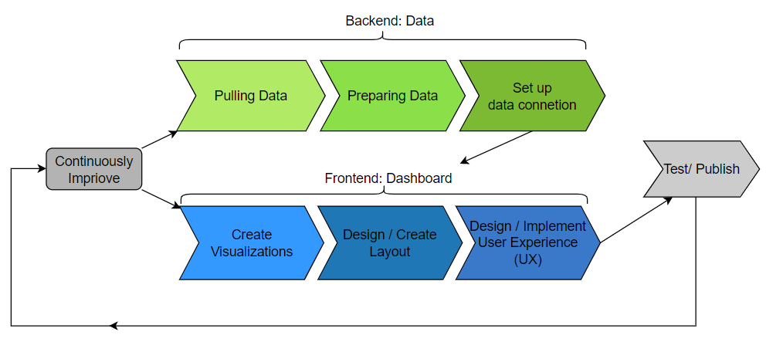
Why should I use dash?
How a dashboard works fully:
Creating powerful data analysis applications
with dash in python

Slide 12
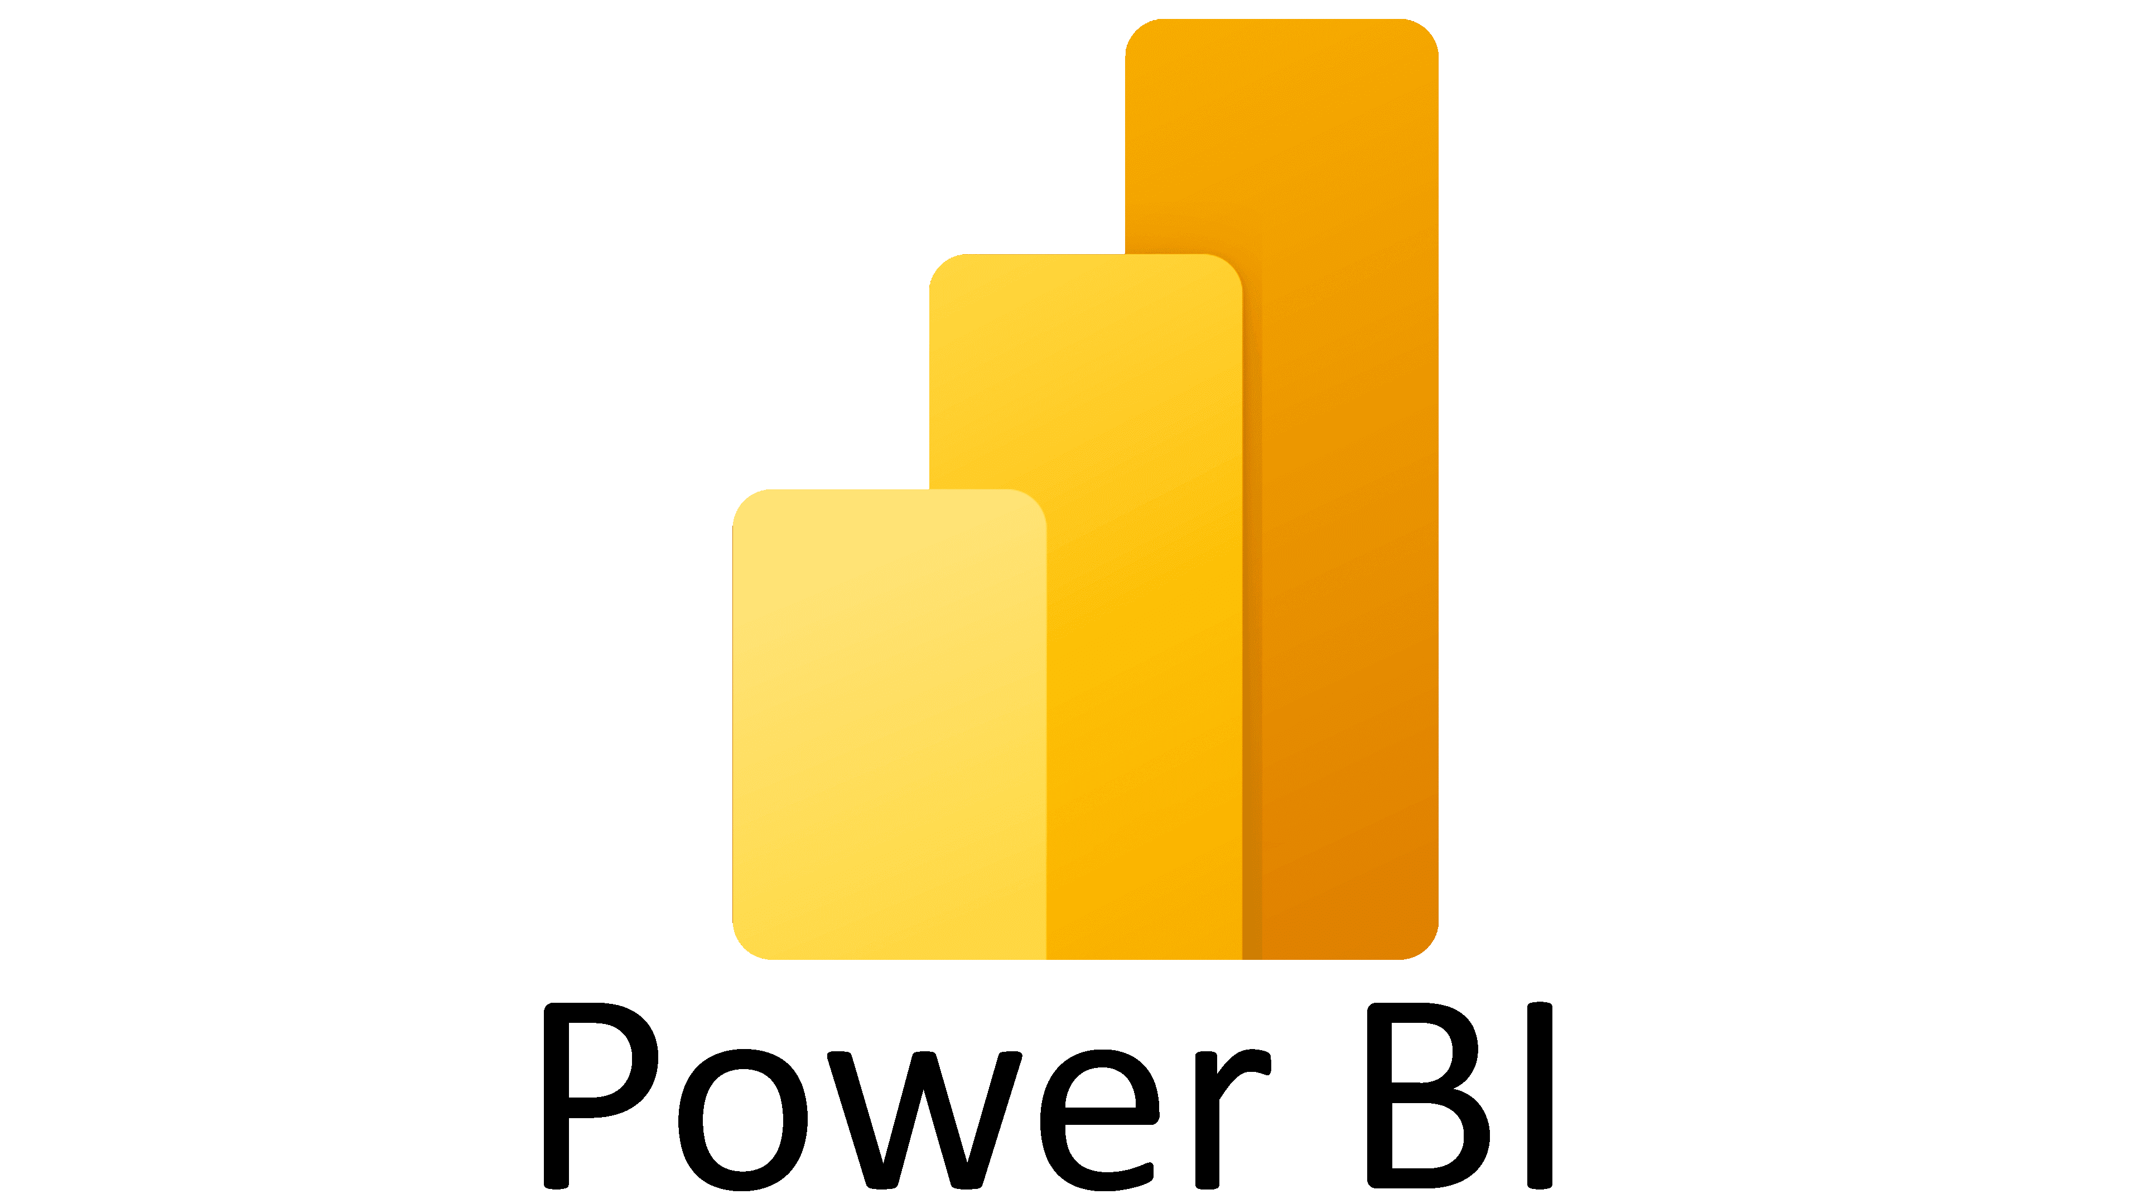


Why should I use dash?
Common tools to create dashboards have a lot of functionalities for filtering data and creating plots.
They are meant to be used by non-coders.
For the most part they work well. However, they have some disadvantages.
Creating powerful data analysis applications
with dash in python

Slide 13
Why should I use dash? Pros and cons of common dashboard creation tools
Pros:
Very easy to learn.
No coding experience needed.
Not expensive.
Most general visualization options are available.
Allows for data connections and filtering
Cons:
Restricted to default visualization options.
Impossible to create advanced or highly customized graphs.
Data processing limited.
No options to set specialized user experience.
Creating powerful data analysis applications
with dash in python

Slide 14

Why should I use dash?
Build a dashboard in which we could customize it without the restrictions of a standard dashboard creation tool.
Don’t need/want an overly complicated web resource which could take up learning and technical resources.
NAME OF SESSION

Slide 15



Why should I use dash?
With expanded web design we might have more responsibilities:
html/css for interface web design and styles.
javascript/typescript for web functionalities.
Others like flask/php for routes and submissions management.
A lot to learn there …
Luckily: dash combines all these requirements in an easy to learn, standard structure !
Creating powerful data analysis applications
with dash in python

Slide 16

Usage of dash
Dash is a python library. Dash’s official description is:
Downloaded 800,000 times per month, Dash is the original low-code framework for rapidly building data apps in Python, R, Julia, and F# (experimental).
Written on top of Plotly.js and React.js, Dash is ideal for building and deploying data apps with customized user interfaces. It's particularly suited for anyone who works with data.
You can install it with pip and get going with it.
Creating powerful data analysis applications
with dash in python

Slide 17
Usage of dash: where dash contributes.
We use dash in to create our dashboard (Frontend).
Creating powerful data analysis applications
with dash in python

Slide 18

Usage of dash Core idea:
Layouts:
Visual elements of your dashboard.
Callbacks:
How the visual elements interact with each other.
Creating powerful data analysis applications
with dash in python

Slide 19
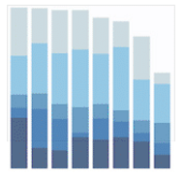
Usage of dash: layout-callback high level example:
Layouts:
Visual elements of your dashboard.
Callbacks:
How the visual elements interact with each other.
function:
If value of dropdown1 == ‘The’: data_filter = data where final_bucket == ‘The’
graph1 == a bar-chart using data_filter
Graph “graph1”
Dropdown : “dropdown1”
Creating powerful data analysis applications
with dash in python

Slide 20

Usage of dash: advantages of the layout-callback model
Intuitive.
Layout allows for freedom in UI design.
Using identifiers for objects in Layout, you can specify the interaction between objects in your callbacks.
Callbacks allows for freedom with python scripting.
Creating powerful data analysis applications
with dash in python

Slide 21

Usage of Dash: basic structure of a dash object.
app.py
from dash import Dash, dcc, html, Input, Output
app = Dash(__name__)
if __name__ == '__main__’: app.run_server(debug=True)
Dash is based in Flask, a python web framework.
Creating a dash object will open a localhost with your web application
Creating powerful data analysis applications
with dash in python

Slide 22
Usage of Dash: basic structure of a dash object.
app.py
from dash import Dash, dcc, html, Input, Output
app = Dash(__name__)
#Layouts :
app.layout = ...
#Callbacks :
@app.callback(...)
def update_output(input_value):
return ...
if __name__ == '__main__’: app.run_server(debug=True)
Once an app object is created, you’ll need to add the two components:
Layout: is created specifying the layout attribute of the dash object.
Callbacks: they are done using decorators on the dash object and functions.
Creating powerful data analysis applications
with dash in python

Slide 23

Usage of Dash: basic structure of a dash object.
In the following two sections we will:
Study how to create a layout in dash, which can be done completely in python.
Present the basic structure of a dash callback, and how to connect visual componente between each other.
Creating powerful data analysis applications
with dash in python

Slide 24

Creating a layout: completely customize your design!
To create layouts, we need further dash extension libraries.
Your Layout will be a list of components. (each component is a visual element of your page).
Components in a layout can be divided into three types:
html components:
For example: containers and text annotations.
Core components:
For example: dropdowns, sliders, inputs, buttons.
Bootstrap components:
Extra components based on bootstrap design.
from dash import html
from dash import dcc
import dash_bootstrap_components as dbc
Creating powerful data analysis applications
with dash in python

Slide 25
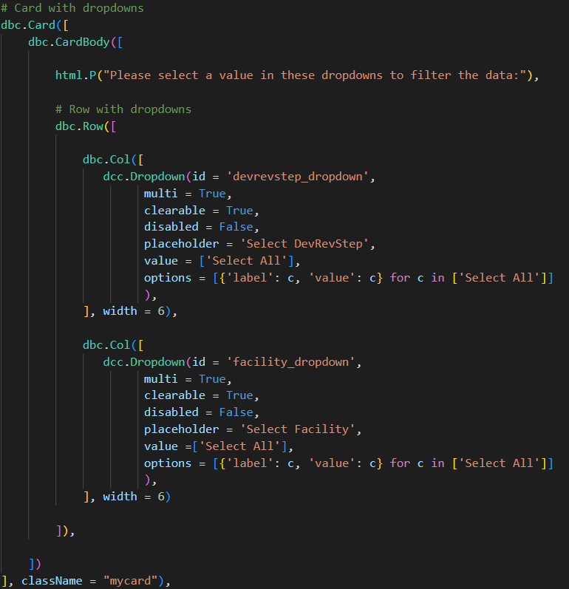
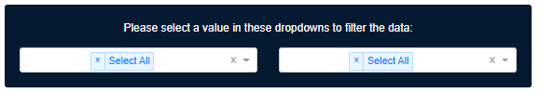
Creating a layout: completely customize your design!
Visually
In code:
Creating powerful data analysis applications
with dash in python

Slide 26
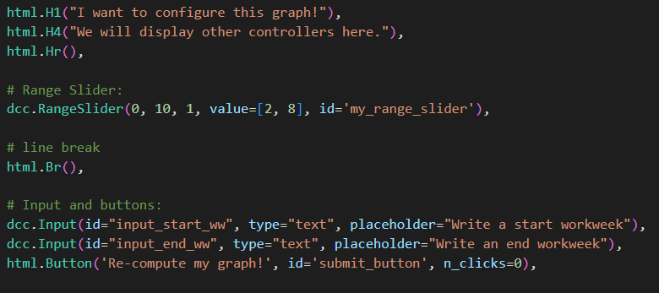
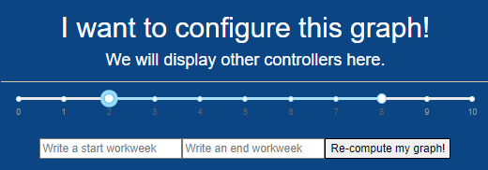
Creating a layout: completely customize your design!
Visually
In code:

Slide 27
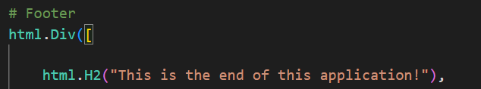
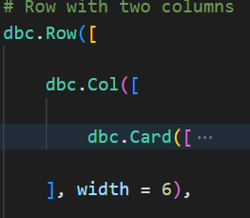
Creating a layout: completely customize your design!
html text tags:
html div’s
dbc Rows and Cols:
(12 columns per row)
Using bootstrap we can employ the Row – Col scheme.
There are 12 columns per row.
Creating powerful data analysis applications
with dash in python

Slide 28
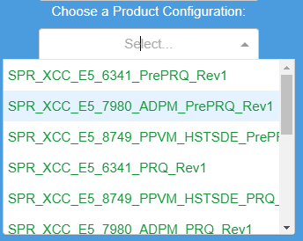
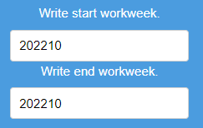
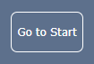
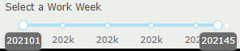
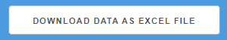
Creating a layout: completely customize your design!
dcc.Dropdown
dcc.Input
dcc. RangeSlider
dcc.Button
Creating powerful data analysis applications
with dash in python

Slide 29
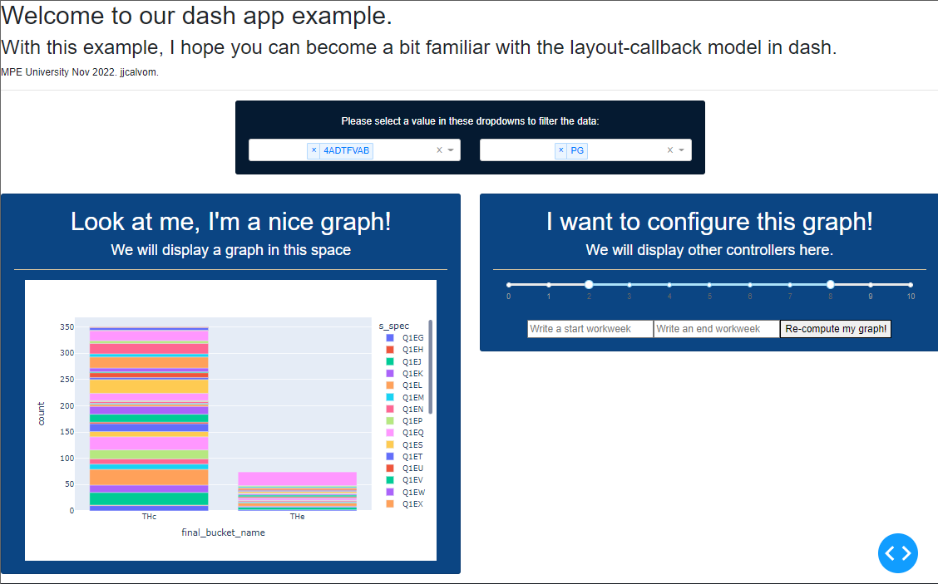
Creating a layout: completely customize your design!
Let’s see an actual example in action of creating components.
Suppose you are interested in creating the following dashboard design:
How to set it up using dash?
Creating powerful data analysis applications
with dash in python

Slide 30

Developing callbacks: what’s going to happen in your dashboard?
Input object
All callbacks are functions with decorators over the app object.
A callback uses the input values of elements in the layout to compute the output values of other elements.
This callback will be triggered when the input objects’ values change.
Value
Callback
Value
Output object
Creating powerful data analysis applications
with dash in python

Slide 31
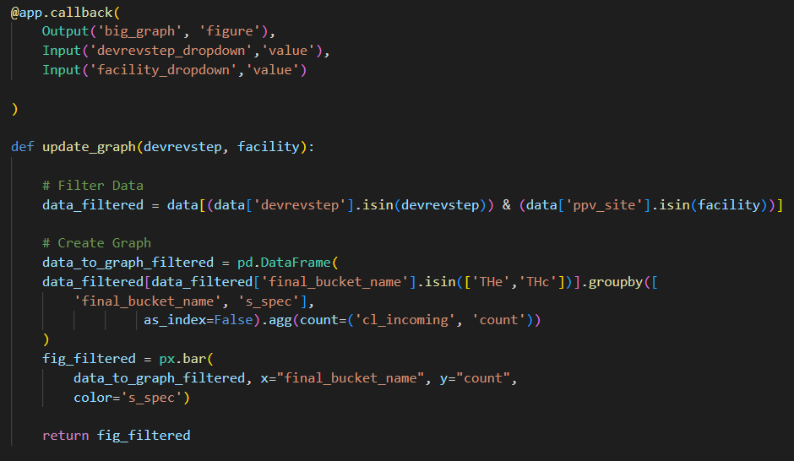
Developing callbacks: what’s going to happen in your dashboard?
What do you think this callback is doing?
A callback example
You can alter several outputs and combine various inputs as well.
No output can be triggered by two callbacks though.
This is a very intuitive and simple way of setting up web functionalities, however it is very powerful.
Can you think of the possibilities?
Creating powerful data analysis applications
with dash in python

Slide 32
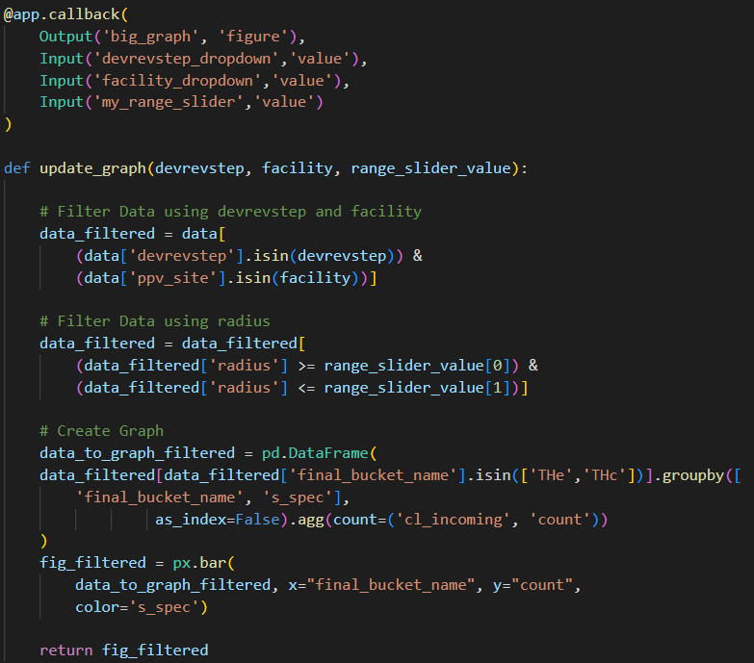

Developing callbacks: what’s going to happen in your dashboard?
Callbacks can alter values of components, but they can also alter the layout.
The output options could be graphs, values, or even html contents.
Wow, that gives us more possibilities!
What do you think this callback is doing?
Creating powerful data analysis applications
with dash in python

Slide 33
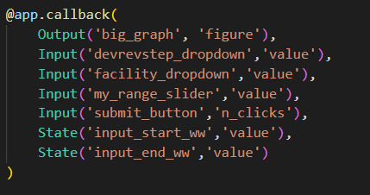
Developing callbacks: what’s going to happen in your dashboard?
Recommendations:
Put a unique id to each element of interest in your layout.
Use the options: Input or State for callbacks when controlling the trigger of a callback.
State option allows you to not set up a callback trigger when a particular value changes.
Example of usage of State option.
Creating powerful data analysis applications
with dash in python

Slide 34

Advanced options: more resources at your disposal.
Memoization:
allows you to bypass long computations by storing the results of function calls
Circular Callbacks:
can be used to keep multiple inputs synchronized to each other.
Catch errors and prevent Update:
In certain situations, you don't want to update the callback output.
And many more:
https://dash.plotly.com/advanced-callbacks

Slide 35
More advanced options: more resources at your disposal.
Using javascript to override Dash template.
Using further extensions as dash datatables or dash tabulator
Upload and Download files

Slide 36
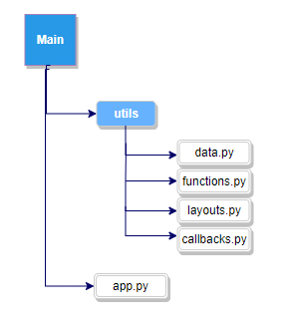
Suggested scaffolding for your application.
When dashboards increase in complexity using one script can be inefficient.
You should spread the layout-callbacks concerns in different folders.
This is the suggested approach to use:
Creating powerful data analysis applications
with dash in python

Slide 37



Publishing a dash app at intel.
Using Cloud Foundry’s python build pack it’s relatively simple to deploy a dash app under an application org.
Check out Sarah Hedberg’s presentation: Hosting a dashboard through Intel Cloud Foundry
Creating powerful data analysis applications
with dash in python

Slide 38


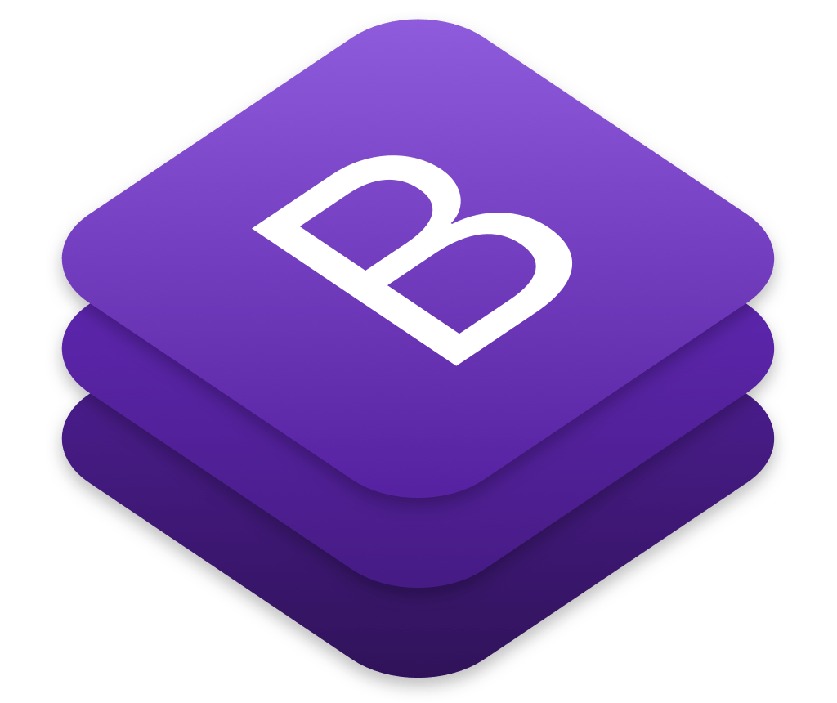
Resources:
https://www.python.org/downloads/
https://dash.plotly.com/introduction
https://dashcheatsheet.pythonanywhere.com/
Install python
dash documentation
Dash bootstrap components cheat sheet/ link-tree

Slide 39

Thank you!
I hope that with this presentation you were able to:
Acknowledge the advantages of using dash for the creation of dashboards.
Understand the basic layout-callback model behind dash.
Become familiar with layout and callback construction at a basic level.
NAME OF SESSION

Slide 40


Share Your Input
We need YOUR feedback to improve for next time!
Please tell us how we did:
goto/MPEUsurvey
goto/mpestats
MPE Global University Survey

